Slide 1
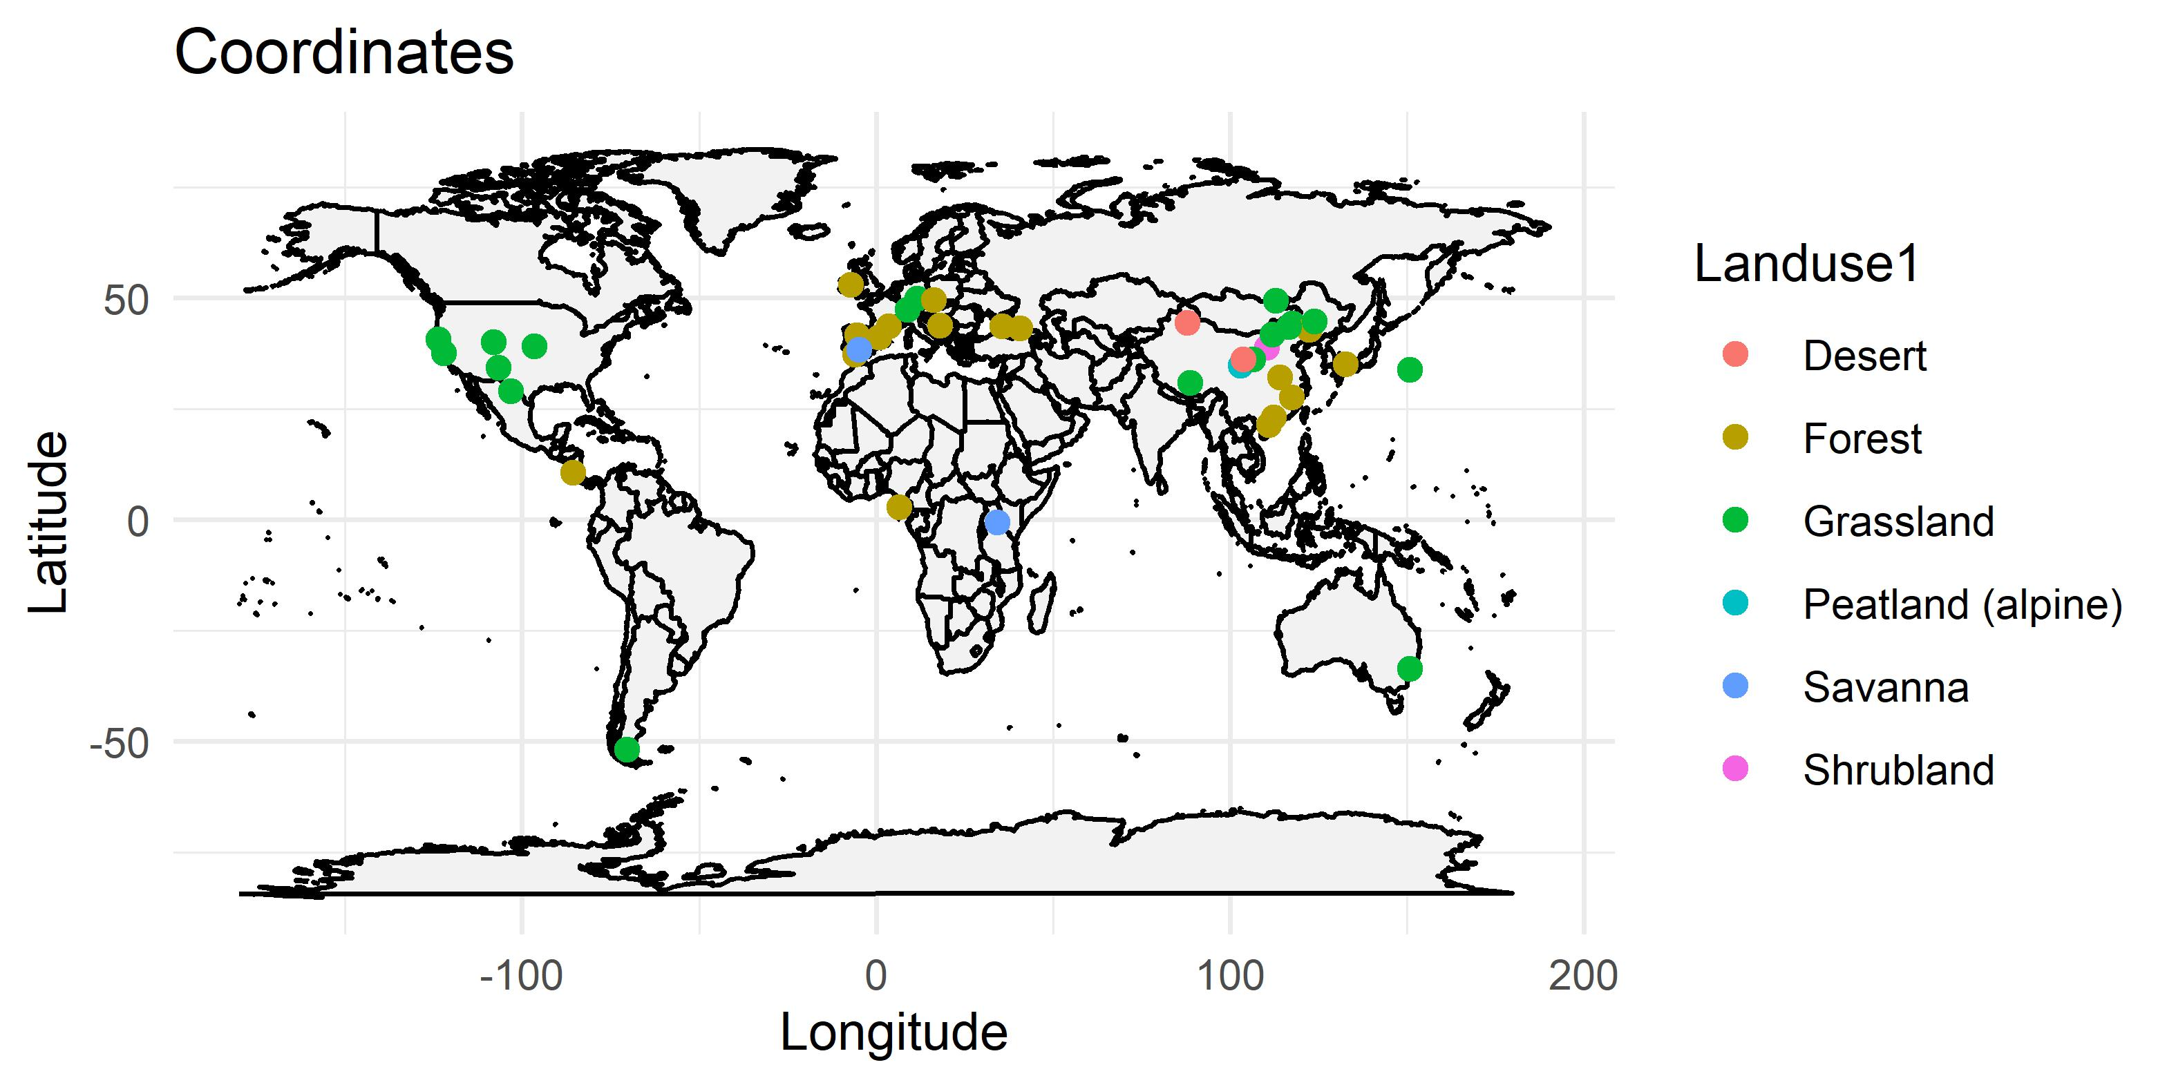
Data are from everywhere
Can we have a simpler land use type?

Slide 2
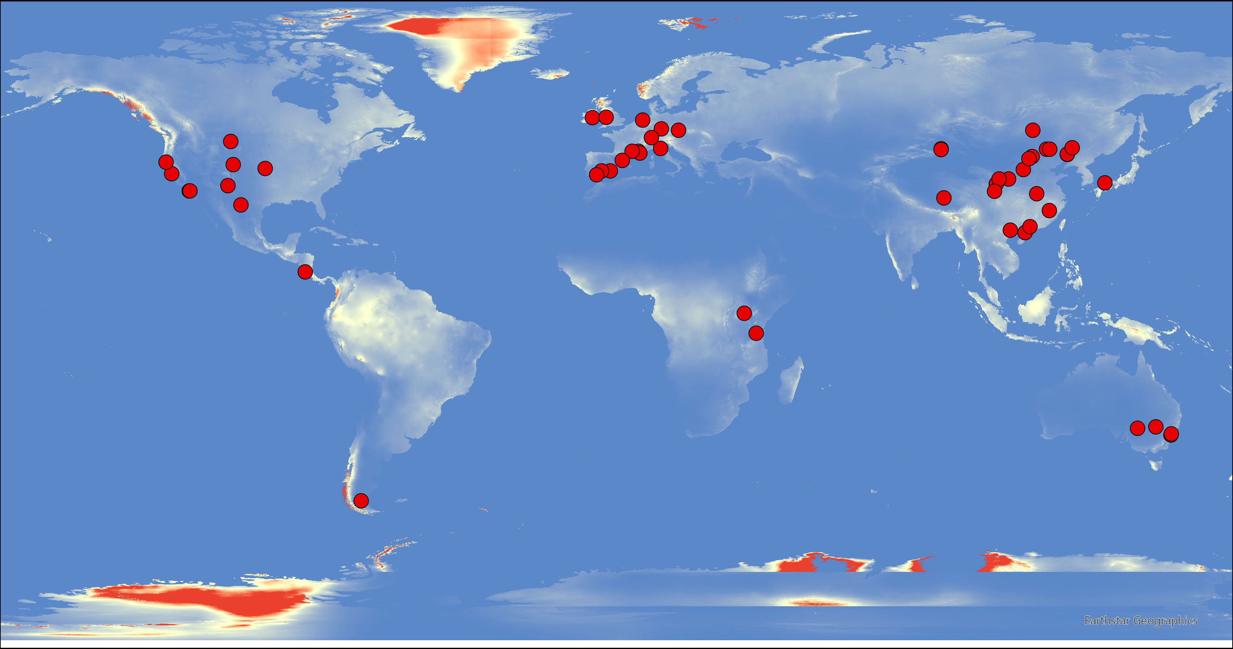
Aridity index

Slide 3
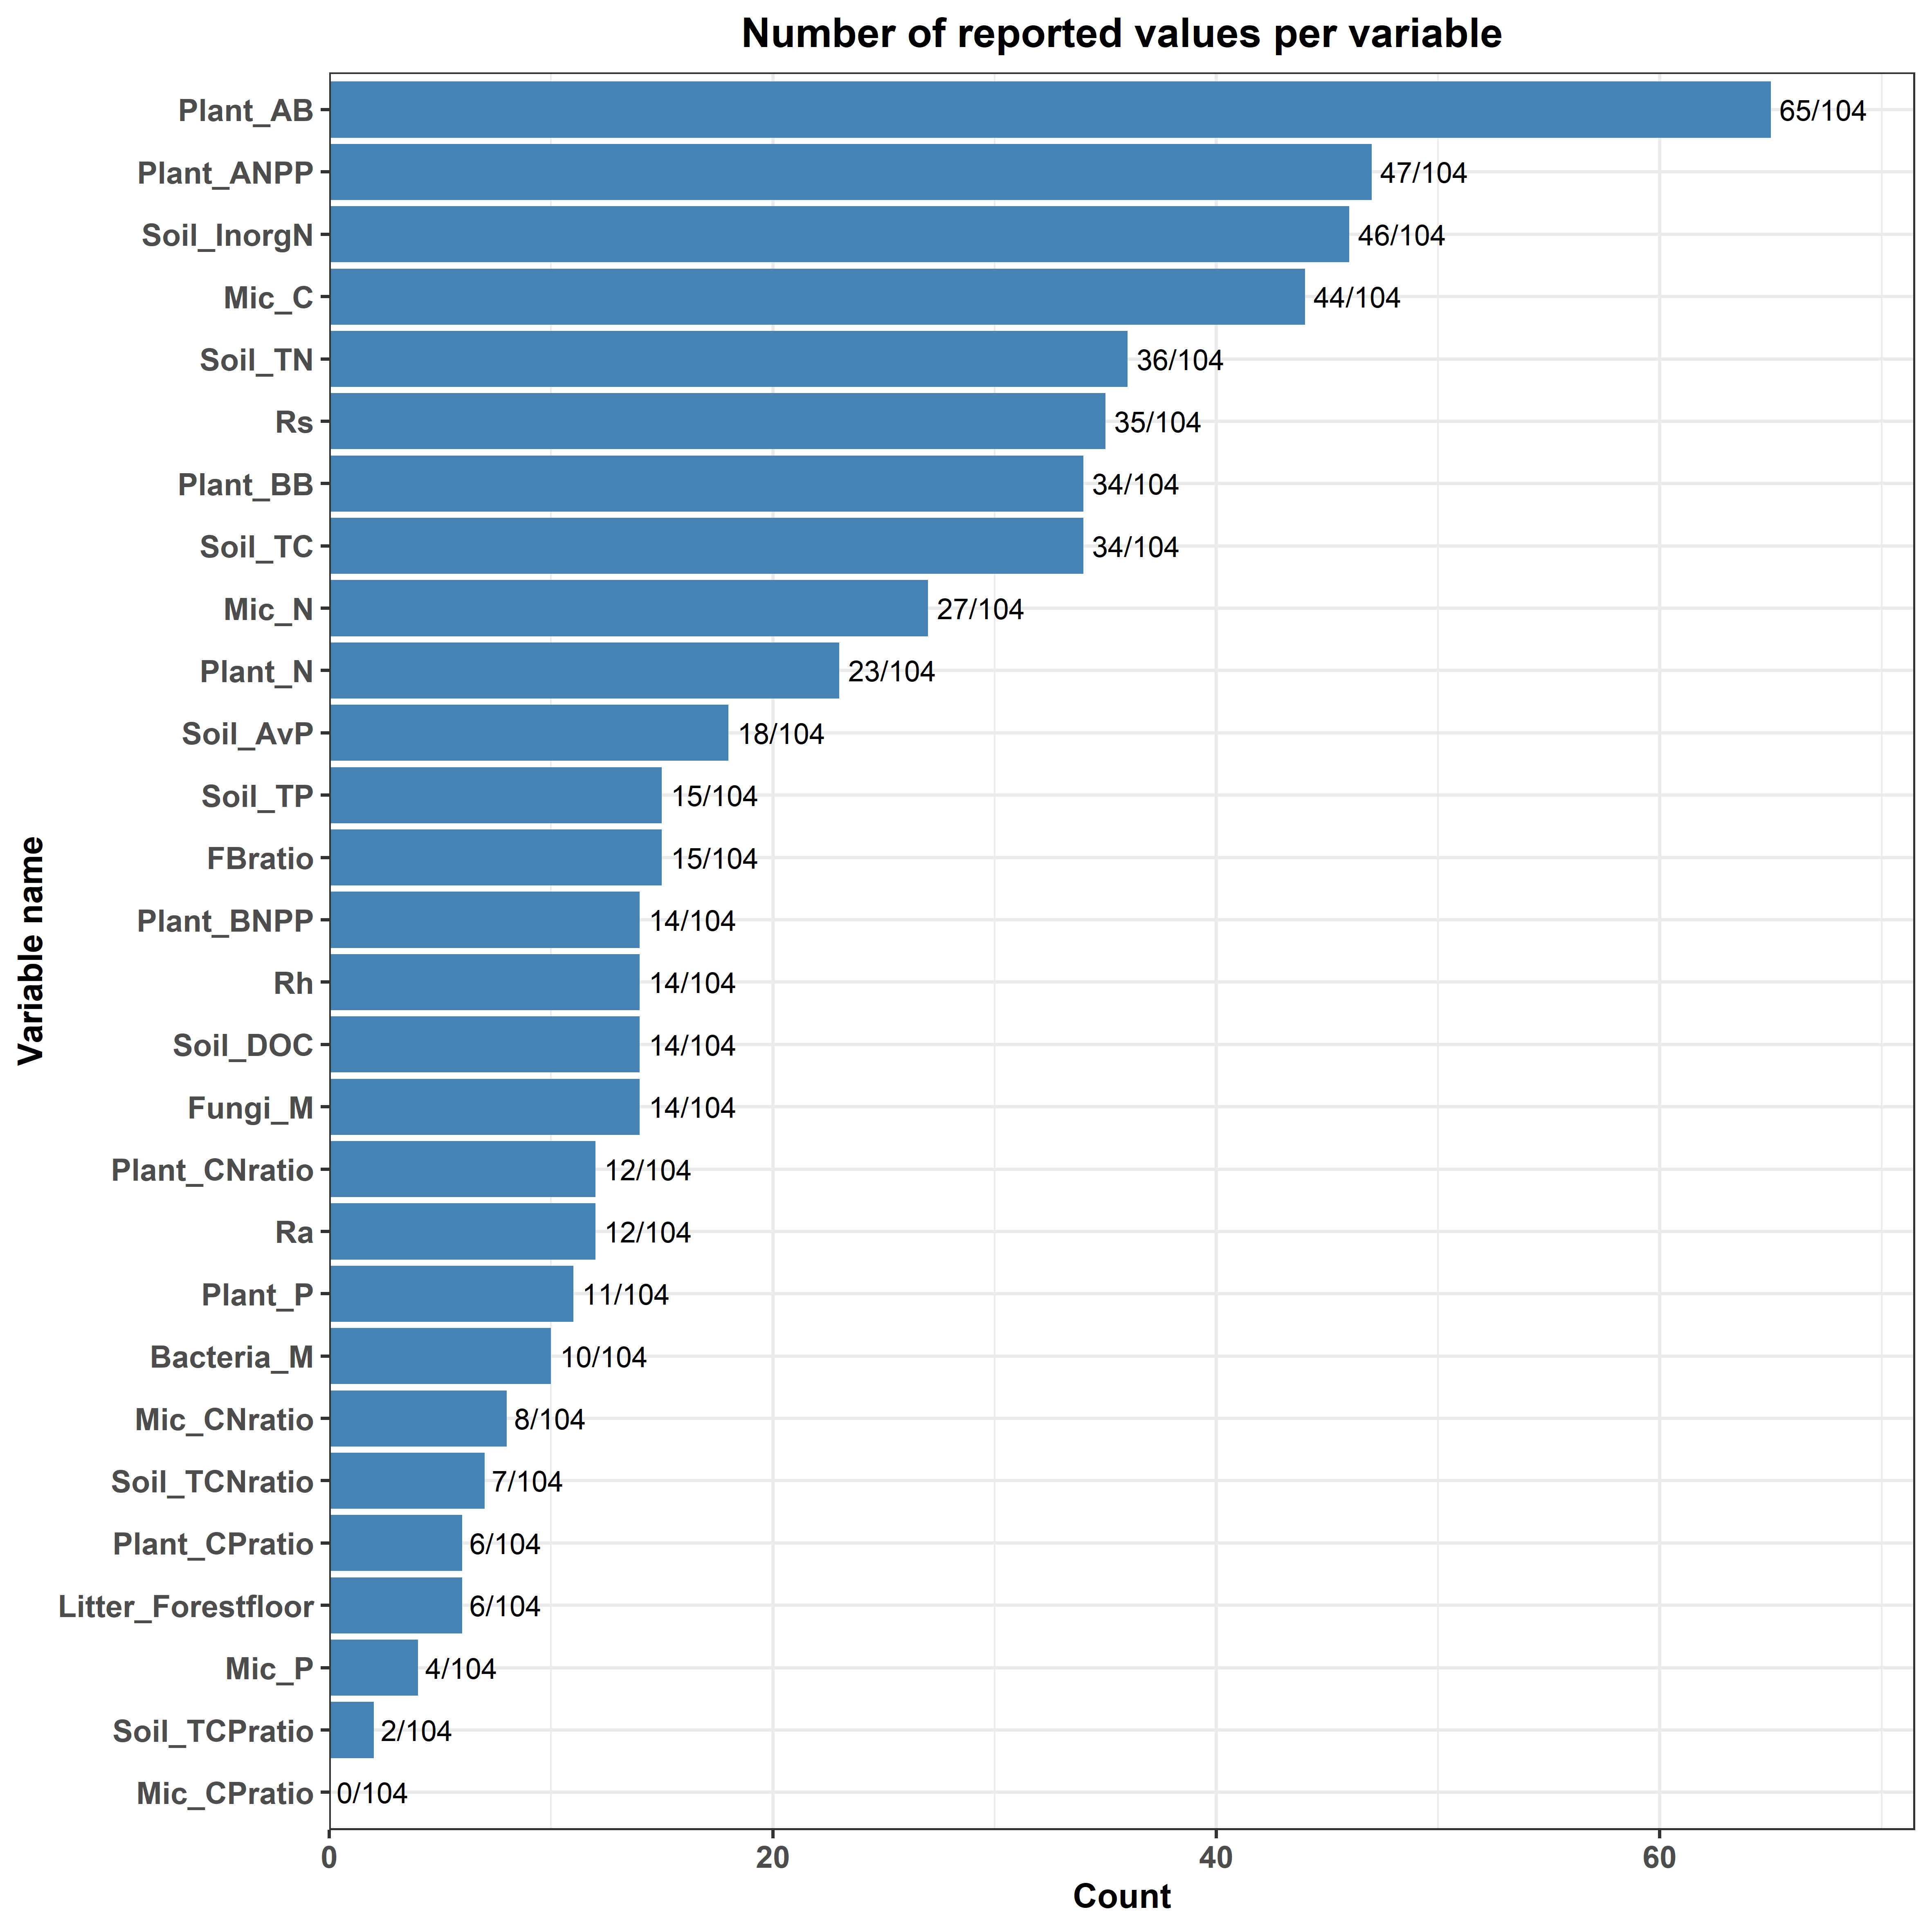
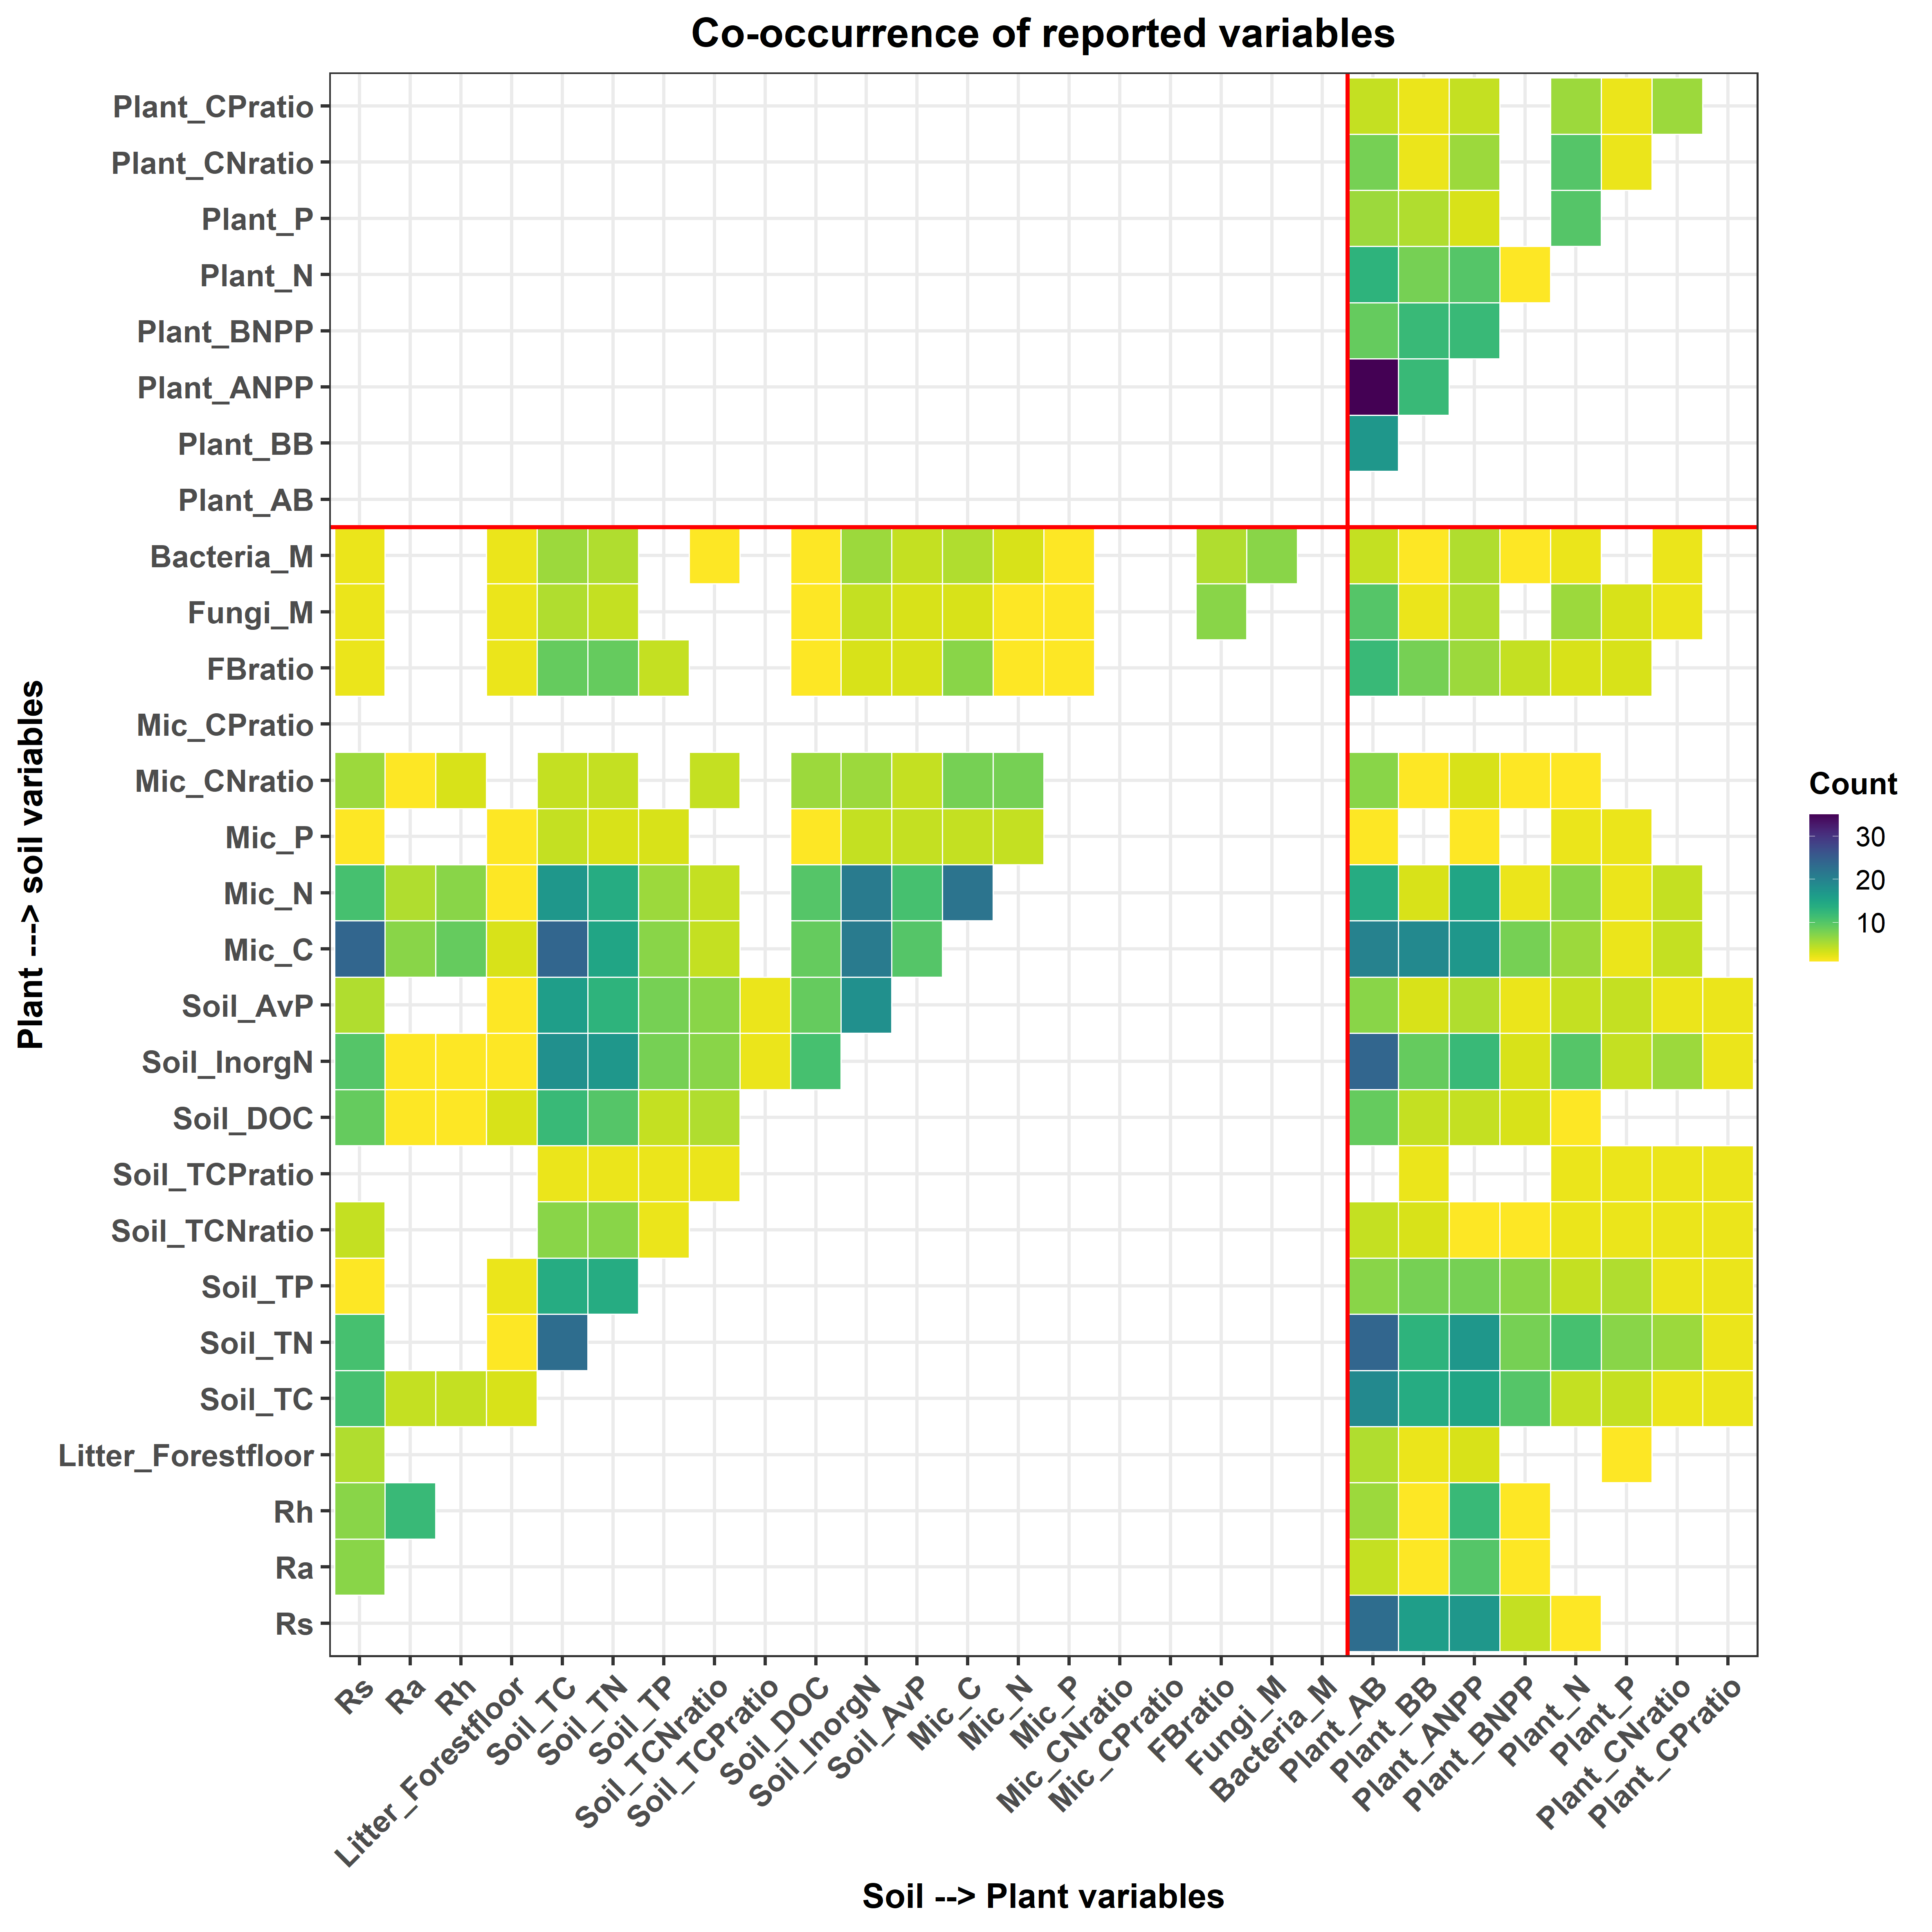
Variable_reporting

Slide 4
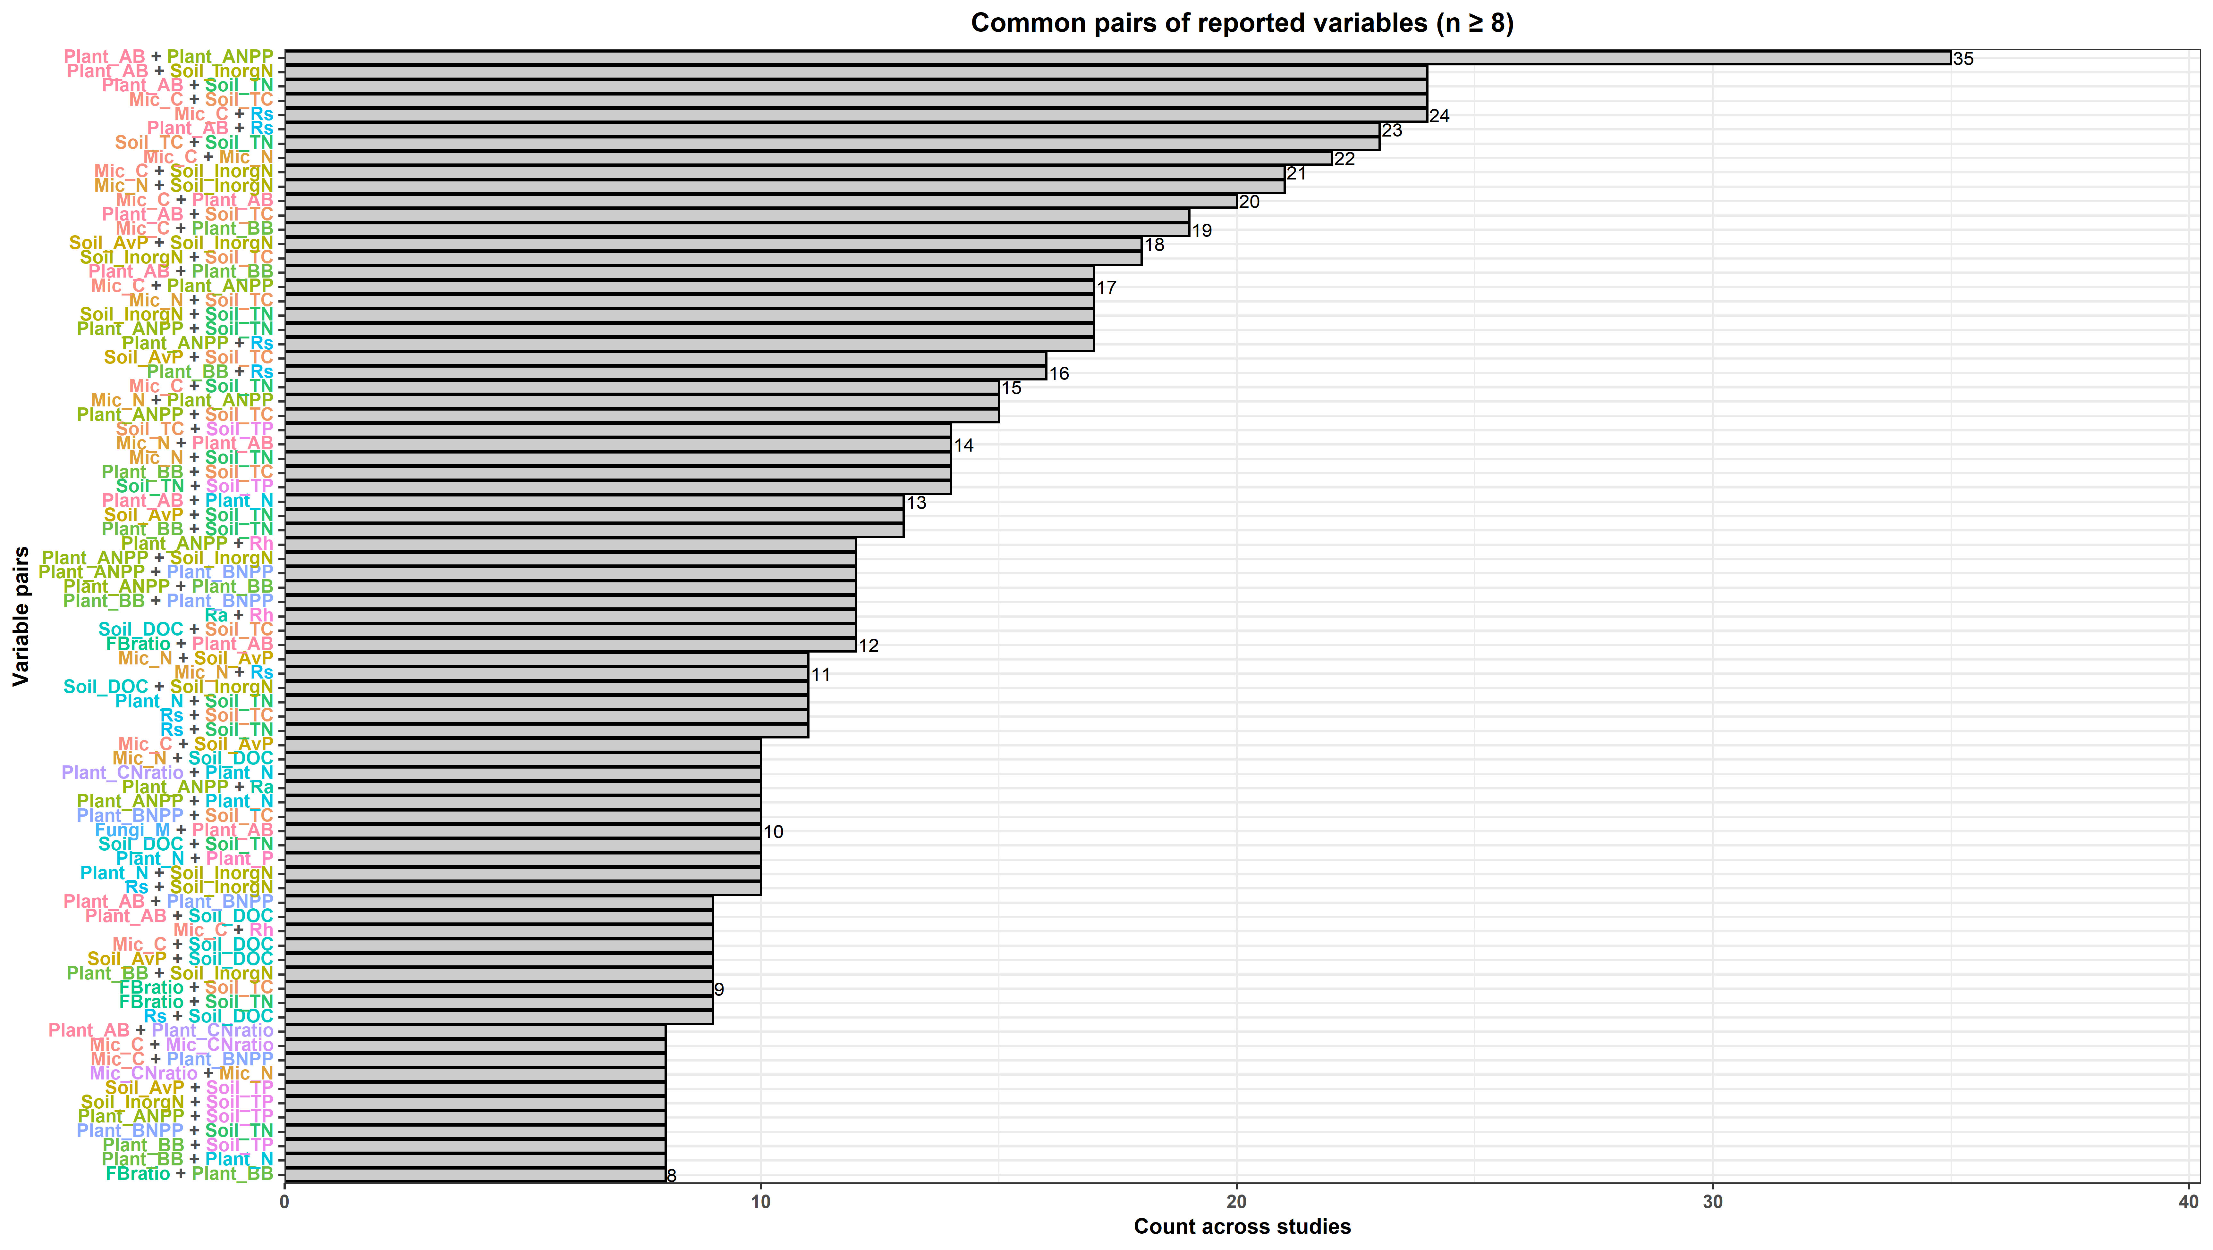
Variable_reporting

Slide 5
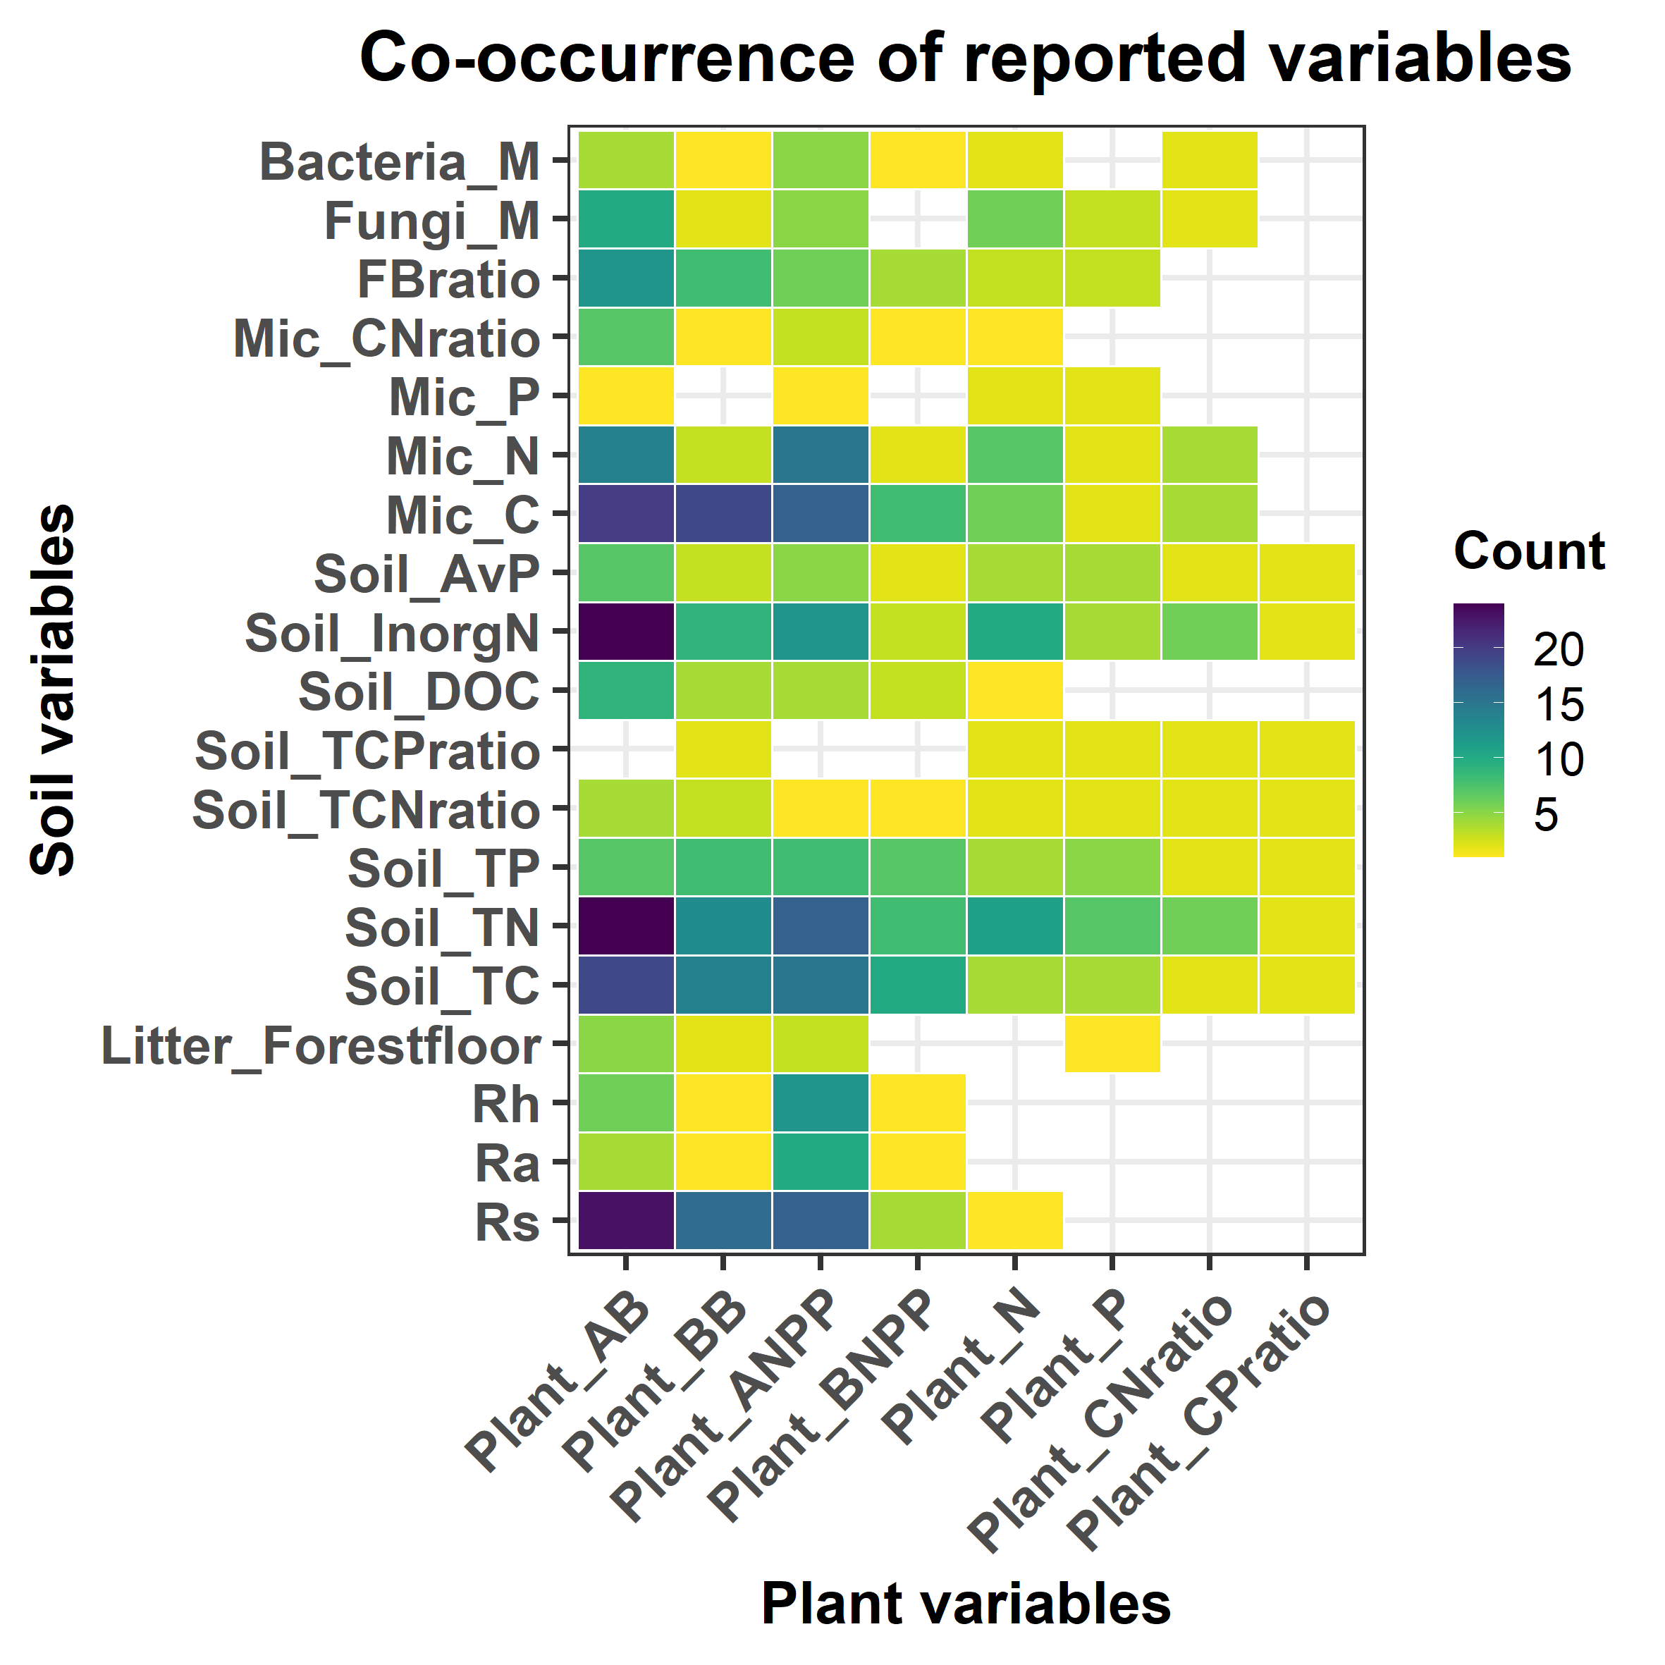
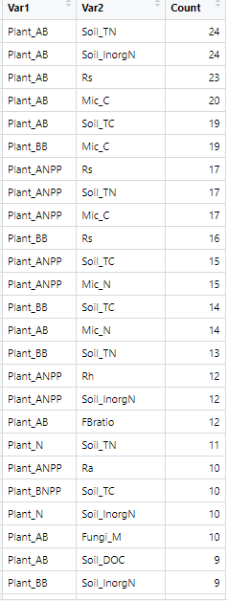
Variable_reporting

Slide 6
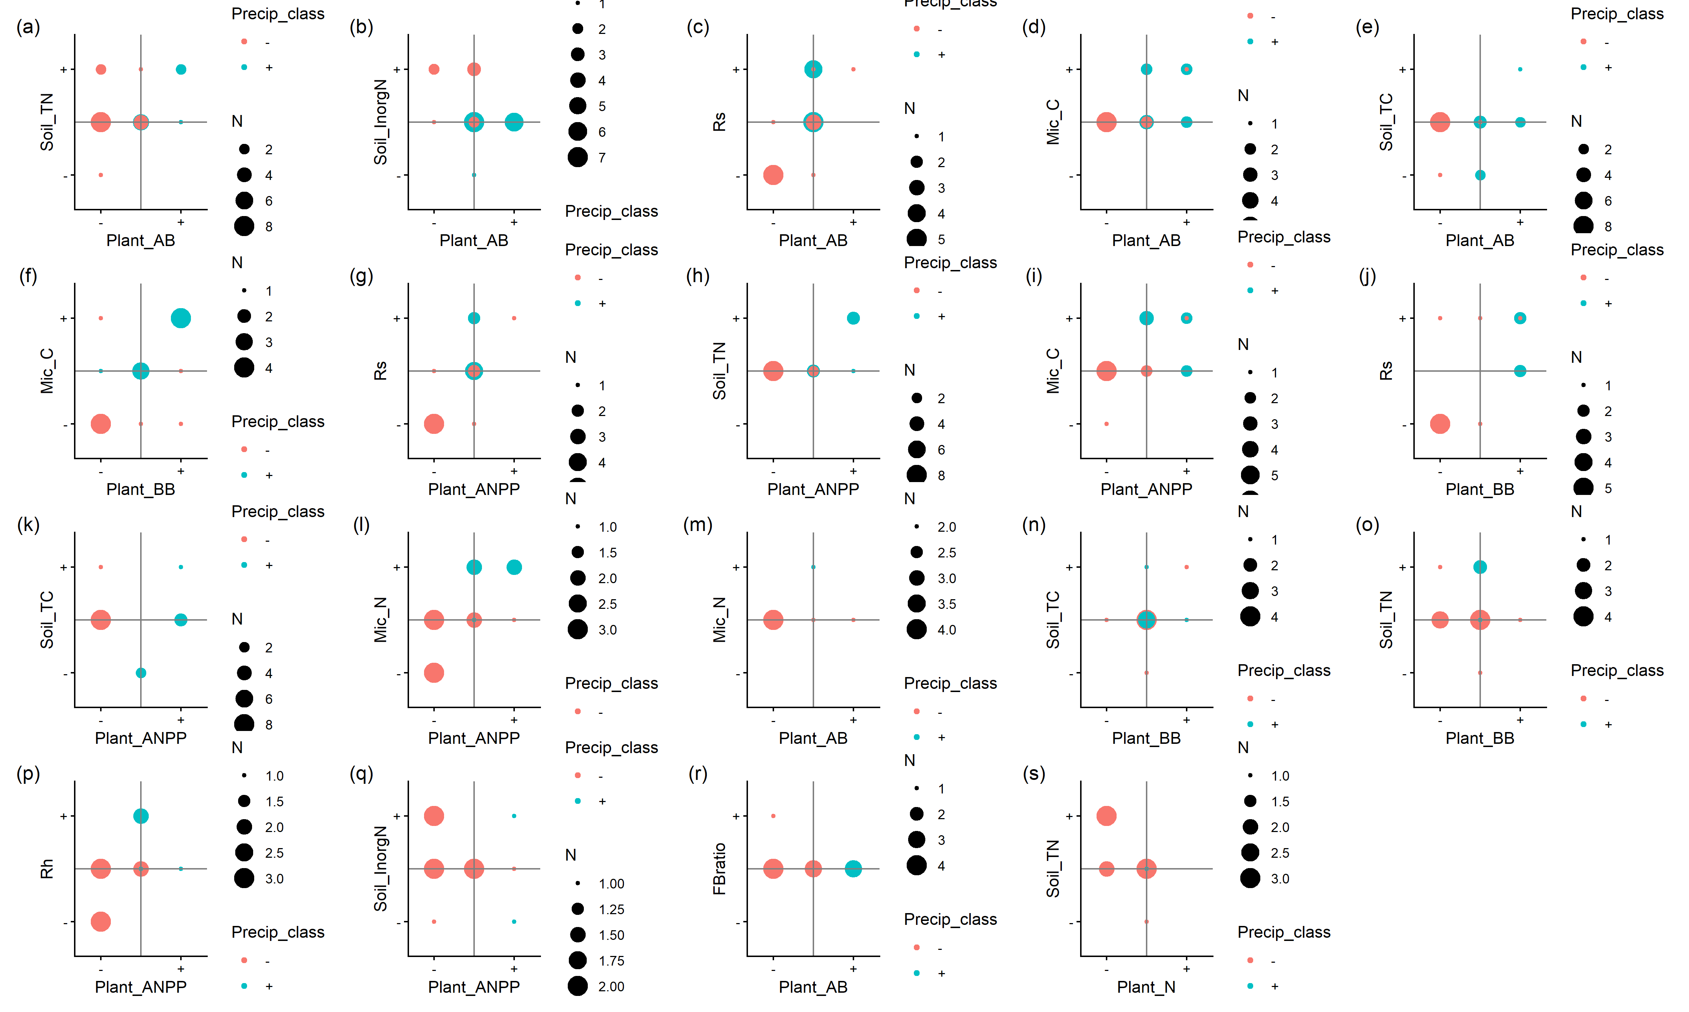
Plant–soil interaction, count >10

Slide 7
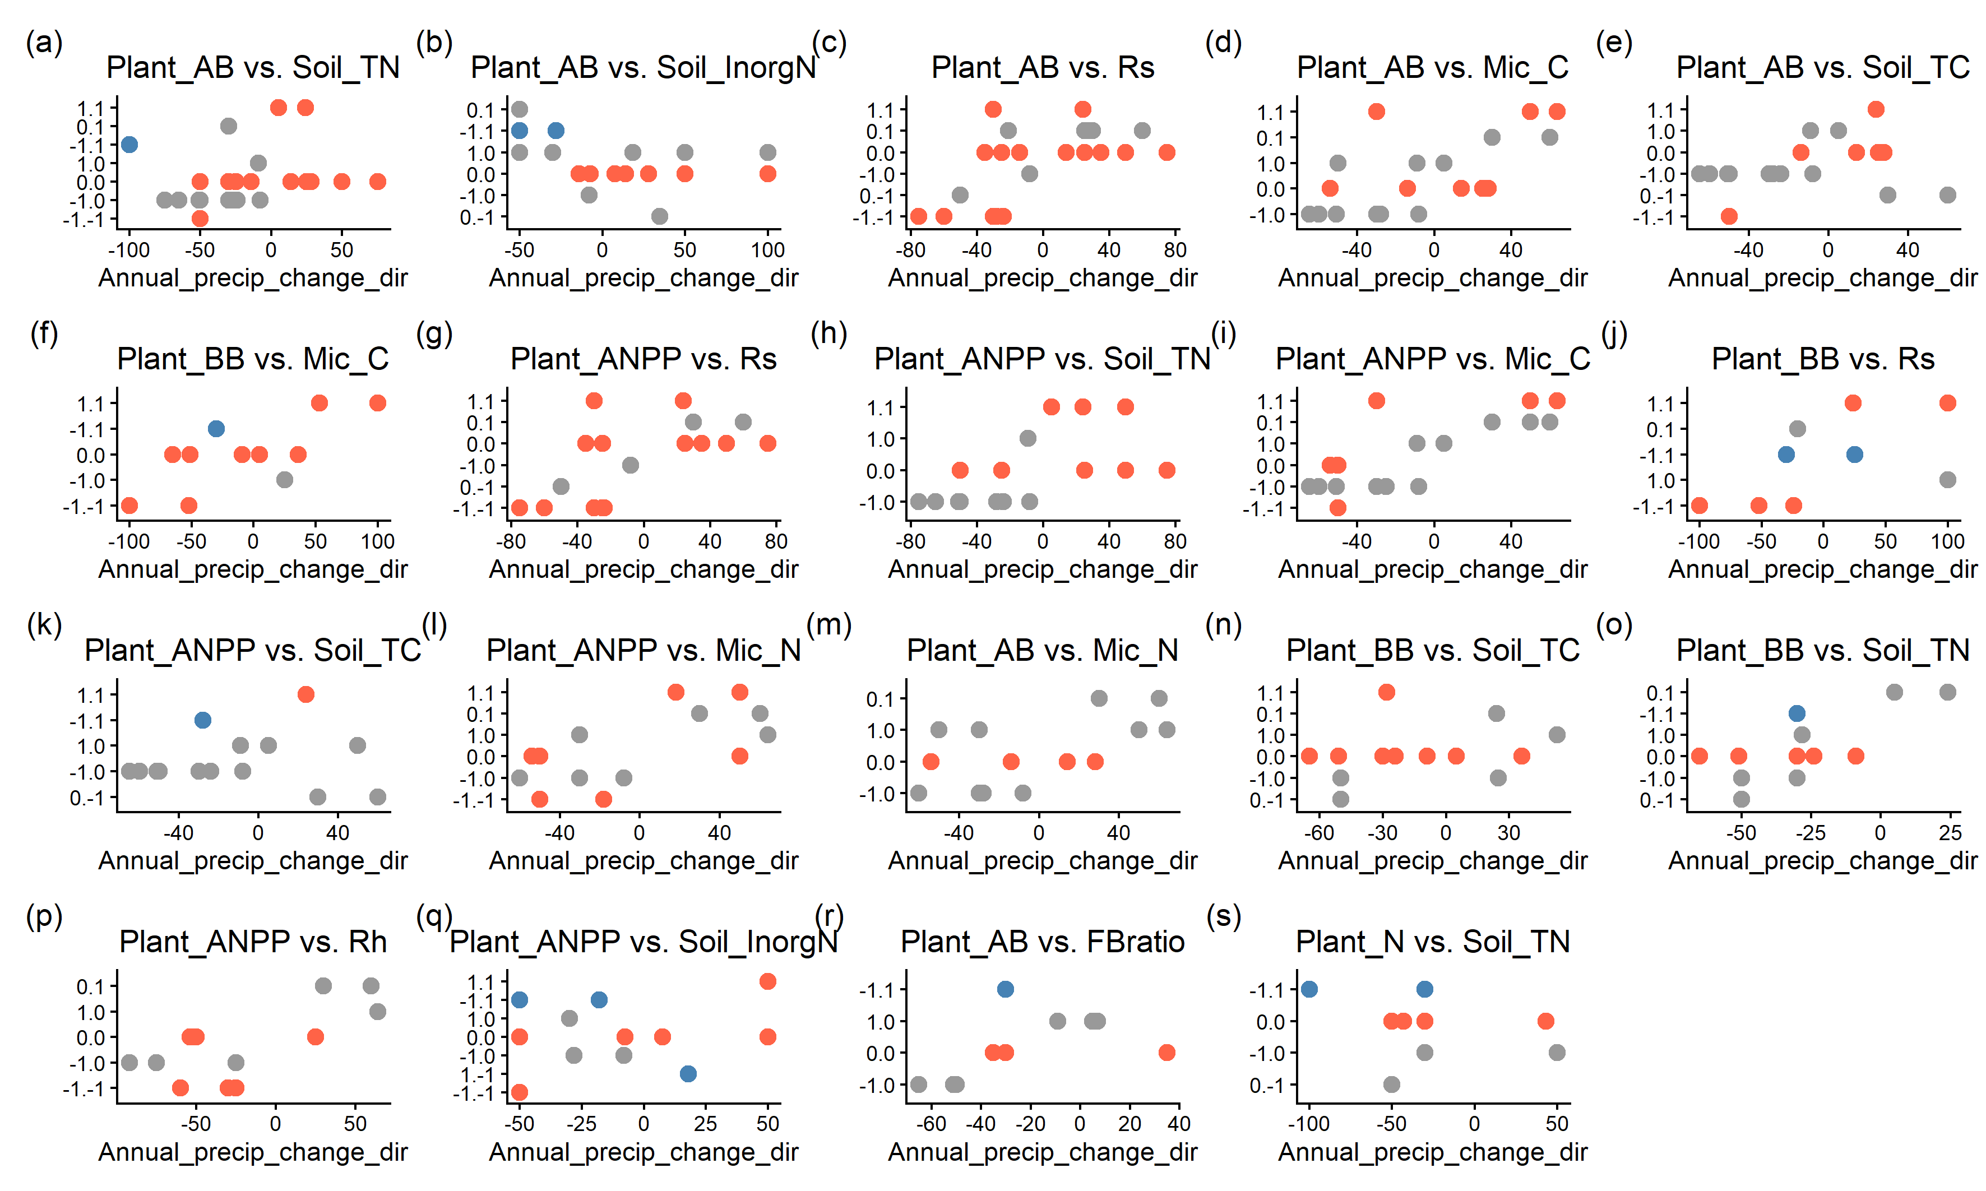
Instead of Precipitation into +, -, what about %

Slide 8
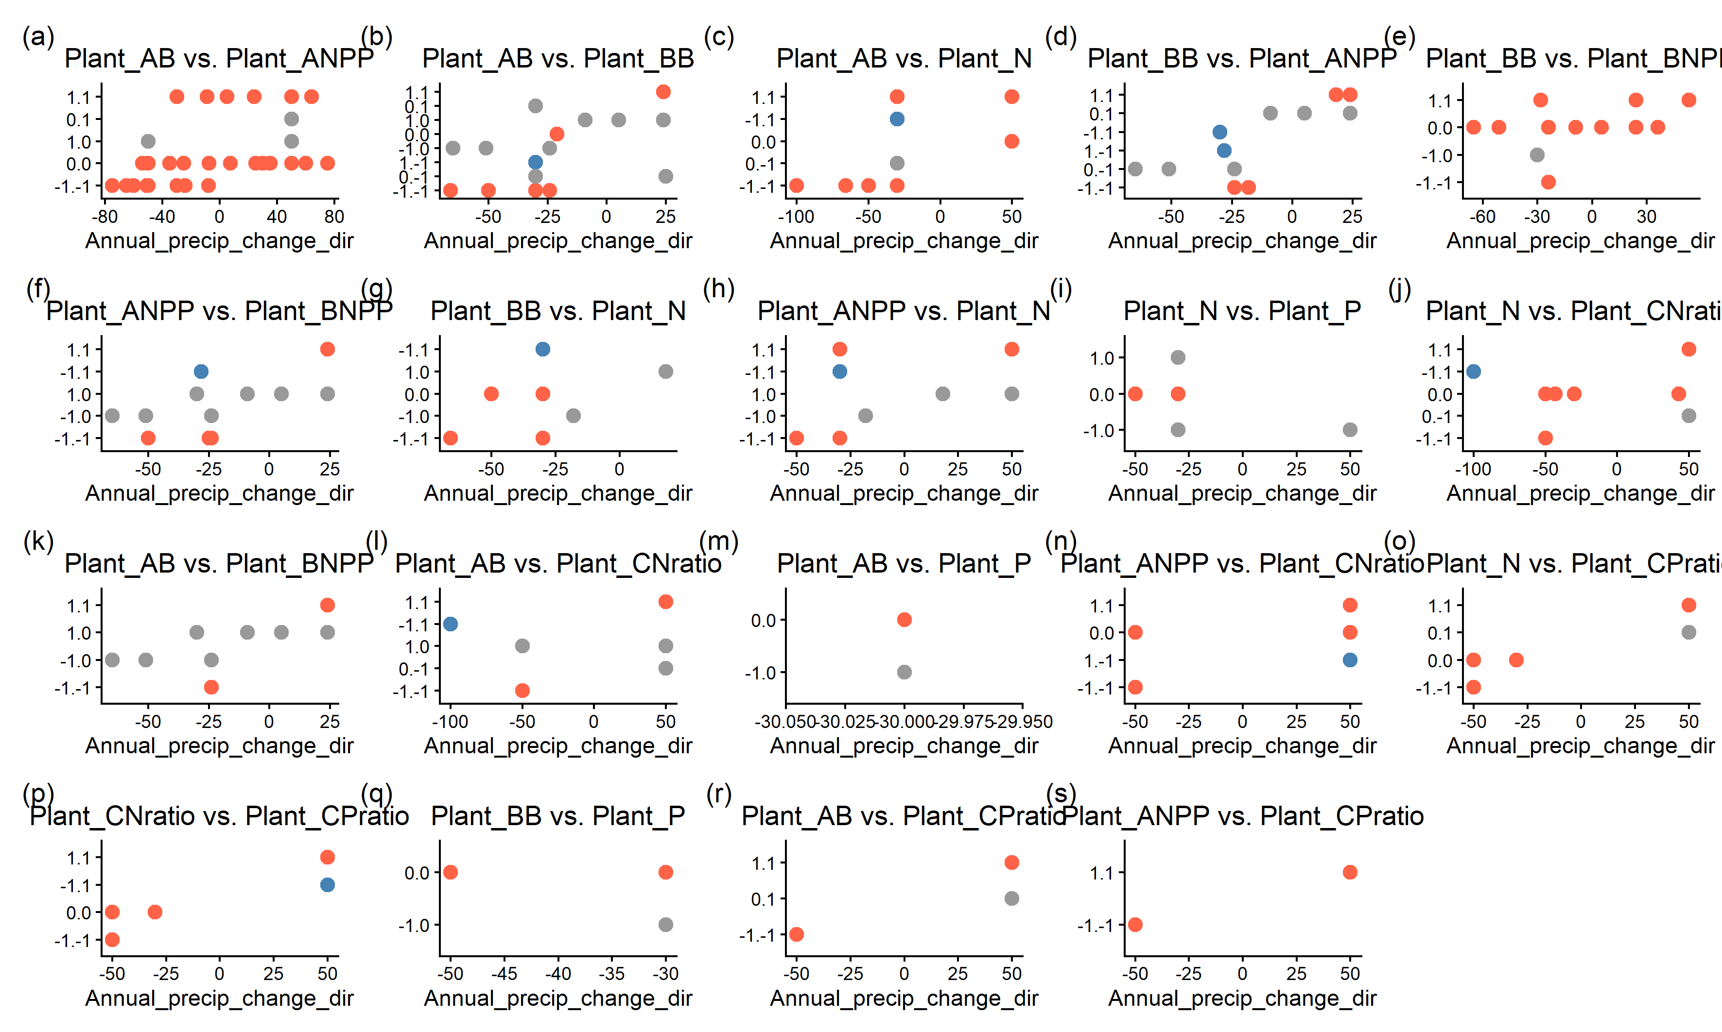
Group data? Which plant vs plants can be grouped? count >2

Slide 9
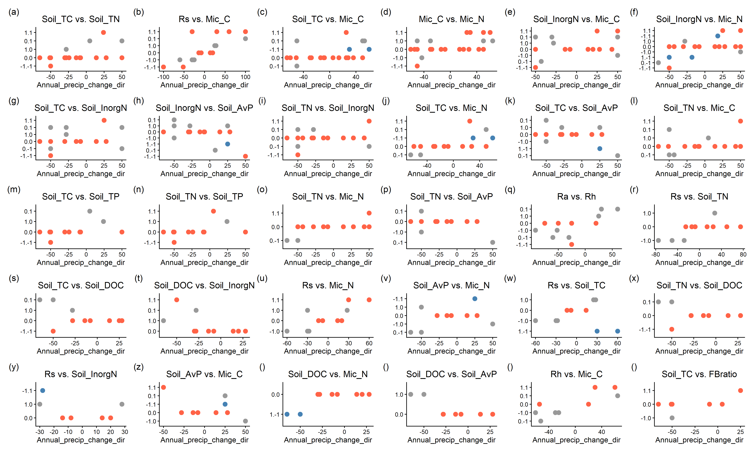
Group data? Which Soil vs Soil can be grouped? count >2

